Slide 1

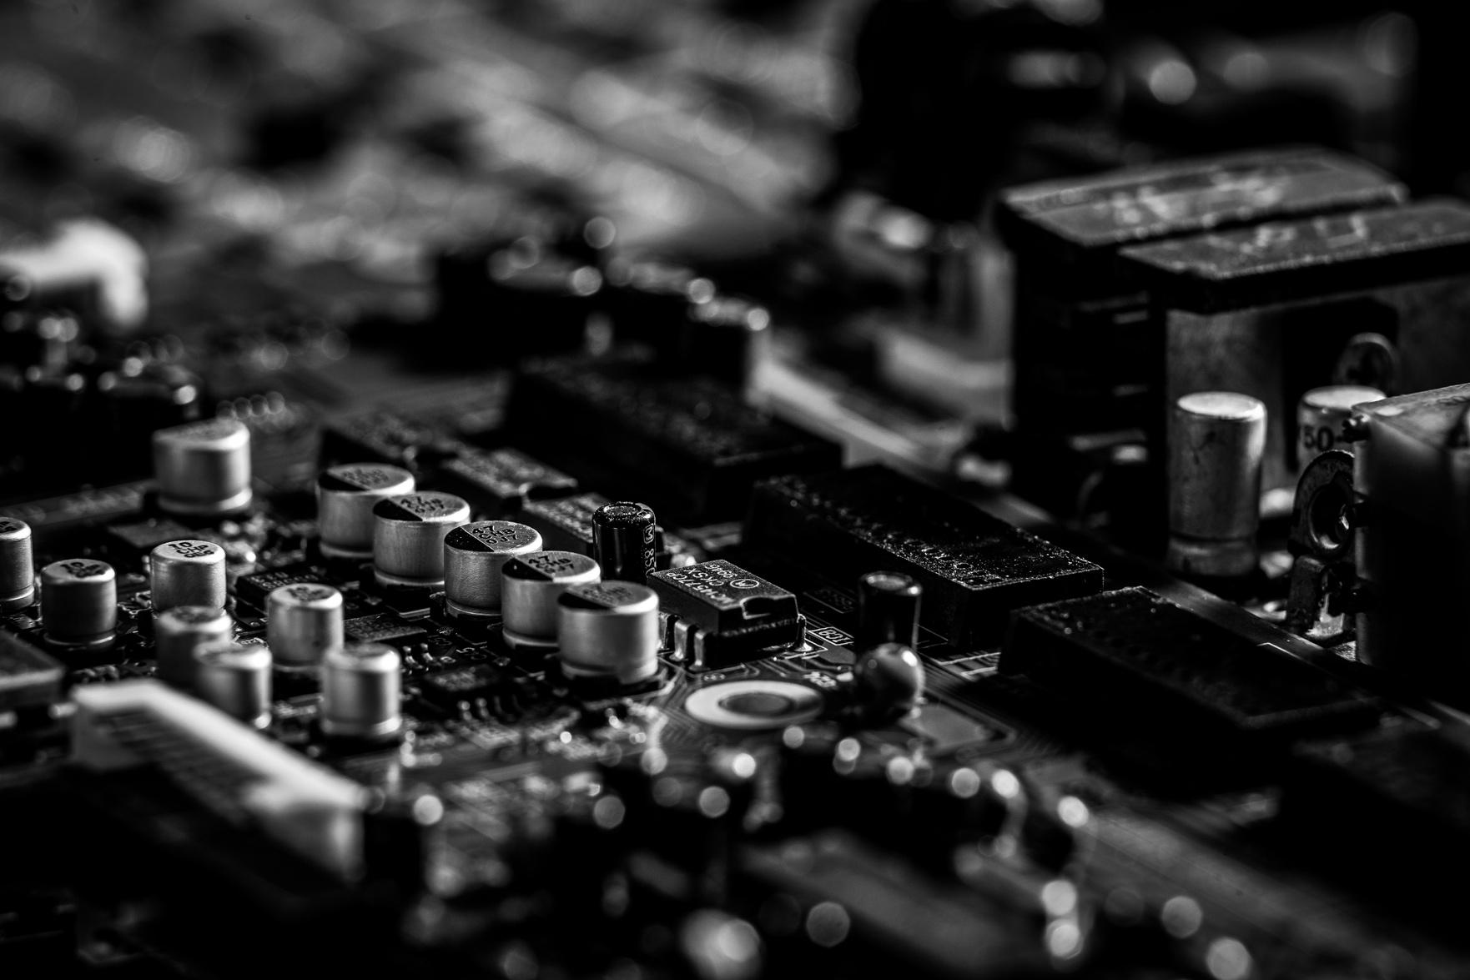
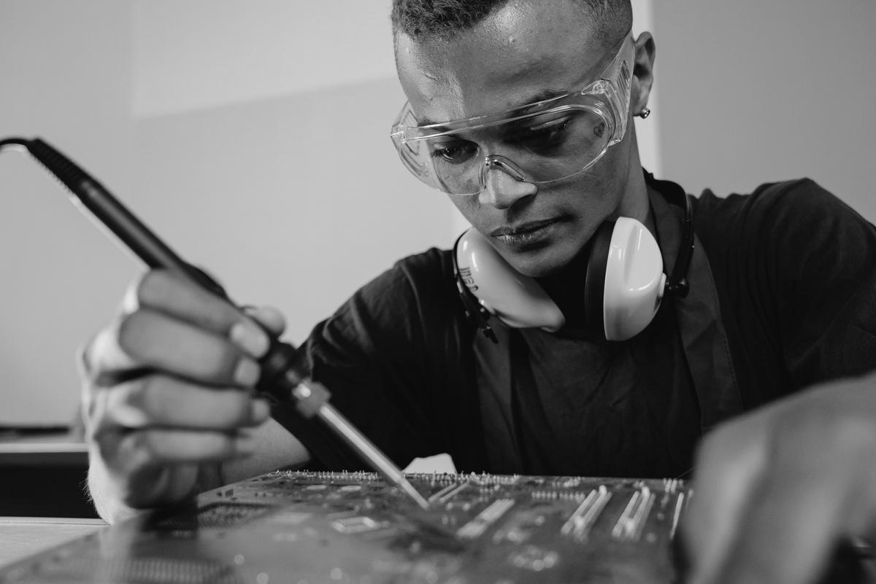
CRAMMING
MORE COMPONENTS ONTO INTEGRATED CIRCUITS
GORDON E. MOORE

Slide 2
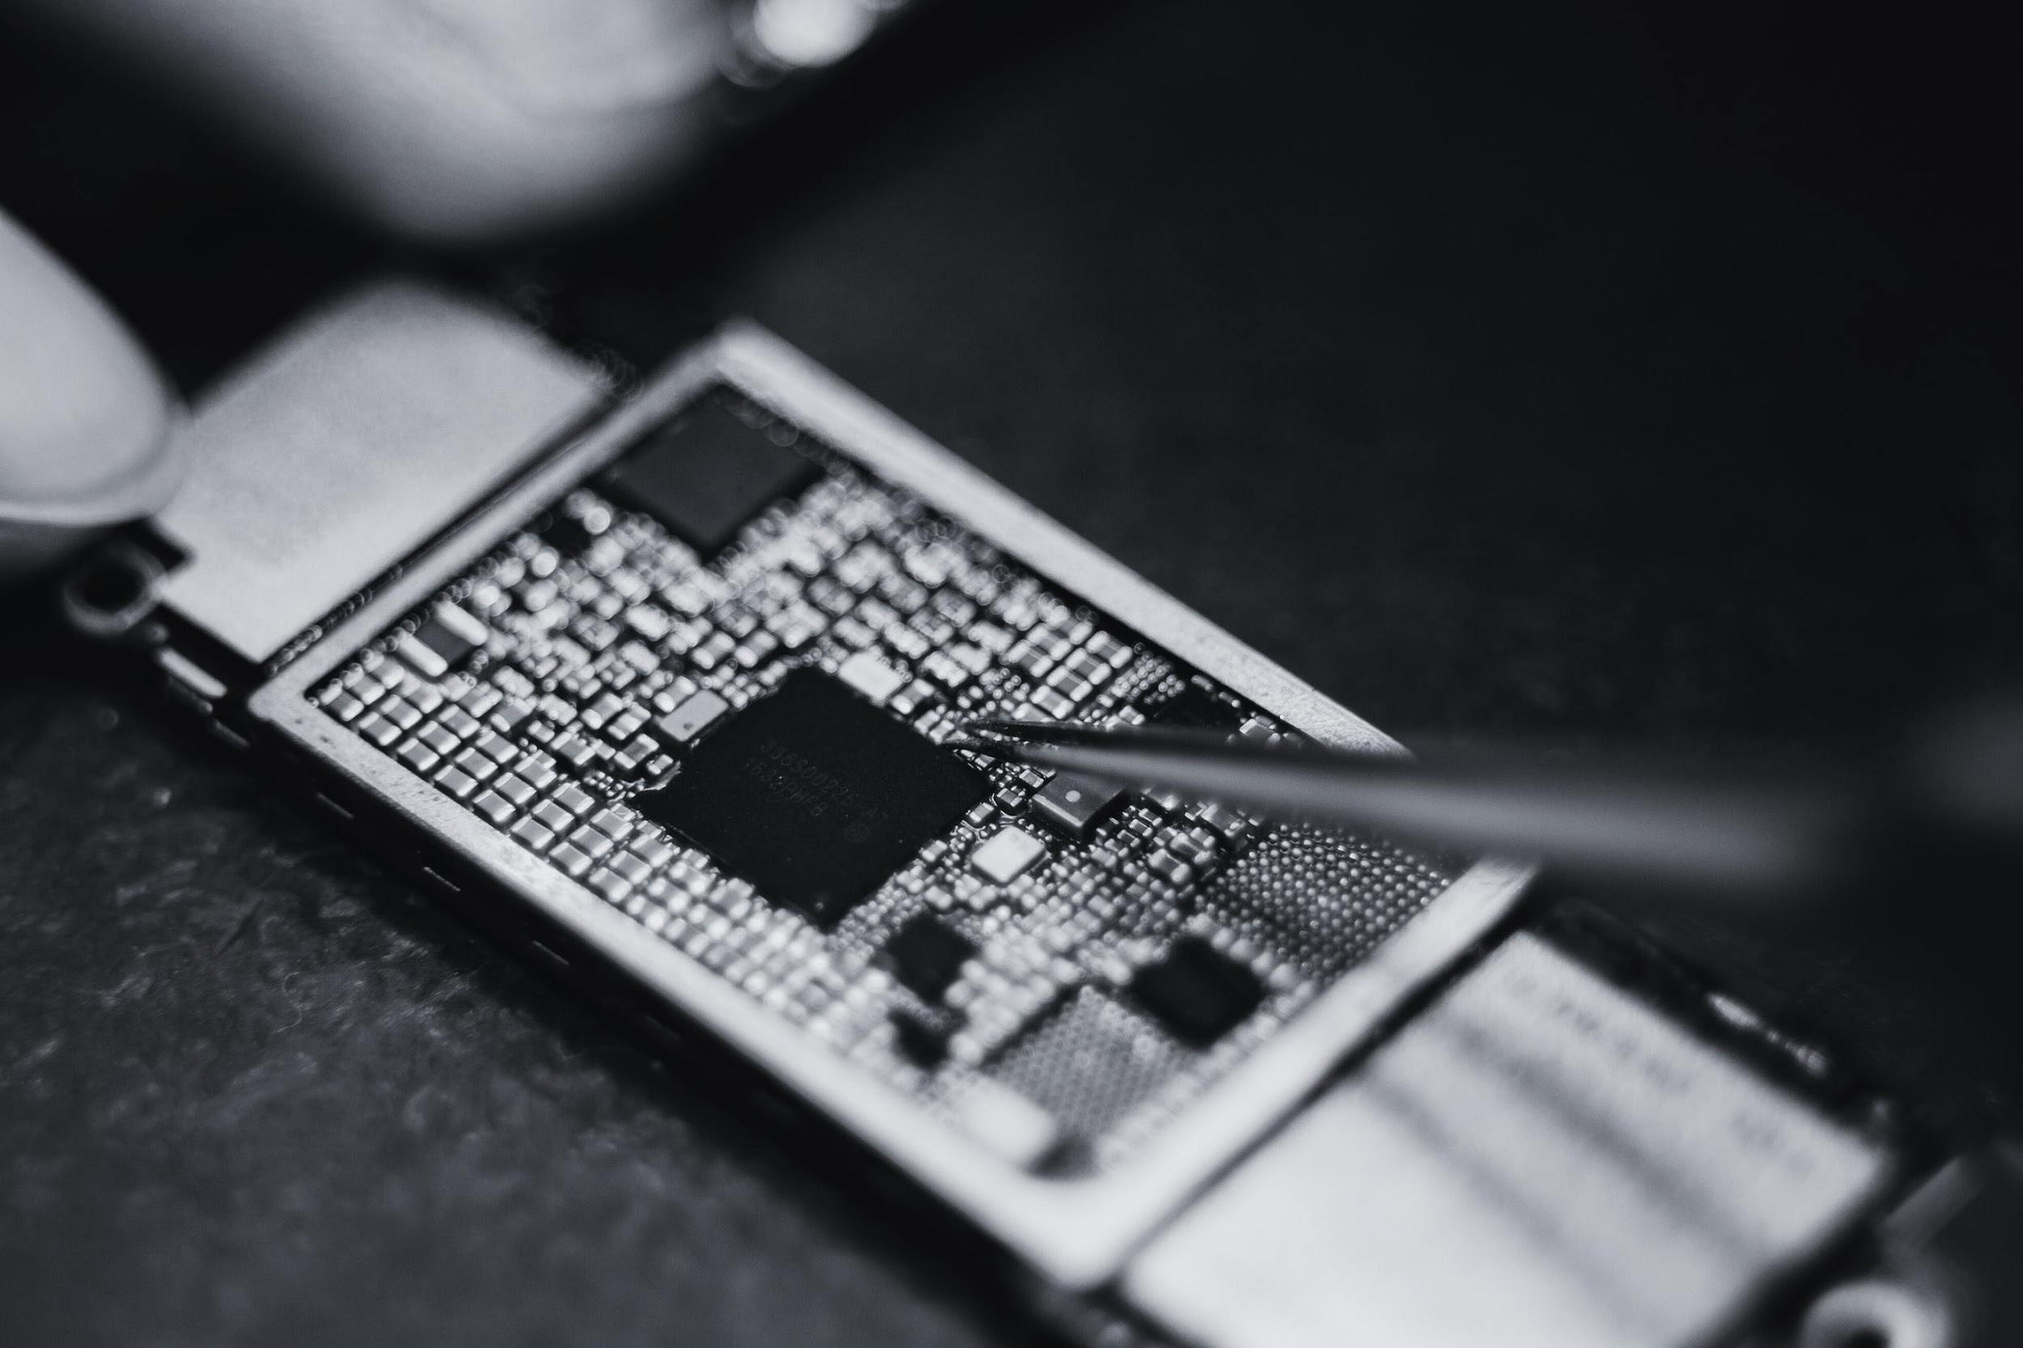
PROMISING
FUTURE
Future of Electronics
Integrated Electronics Brings
  Portable Equipment
  Large Systems
  Computer Architecture
  Reliability
  With unit cost falling as the number of components per circuit rises, by 1975, economics may dictate squeezing as many as 65000 components on a single silicon chip.

Slide 3
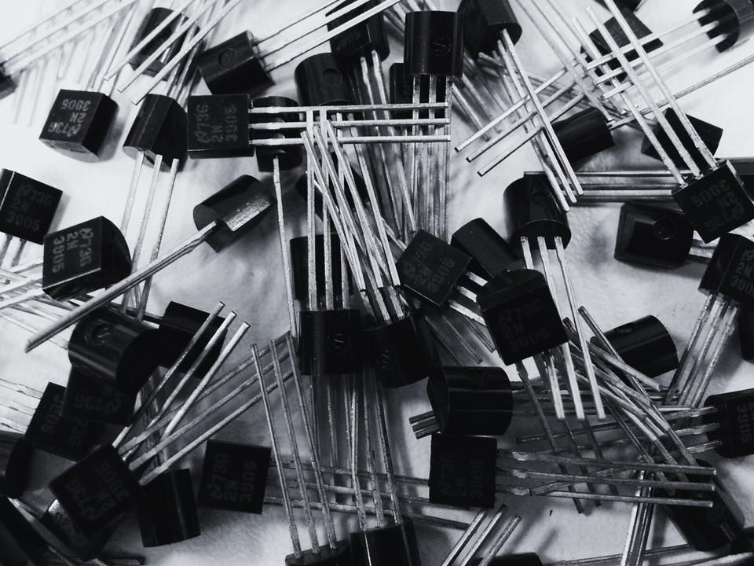
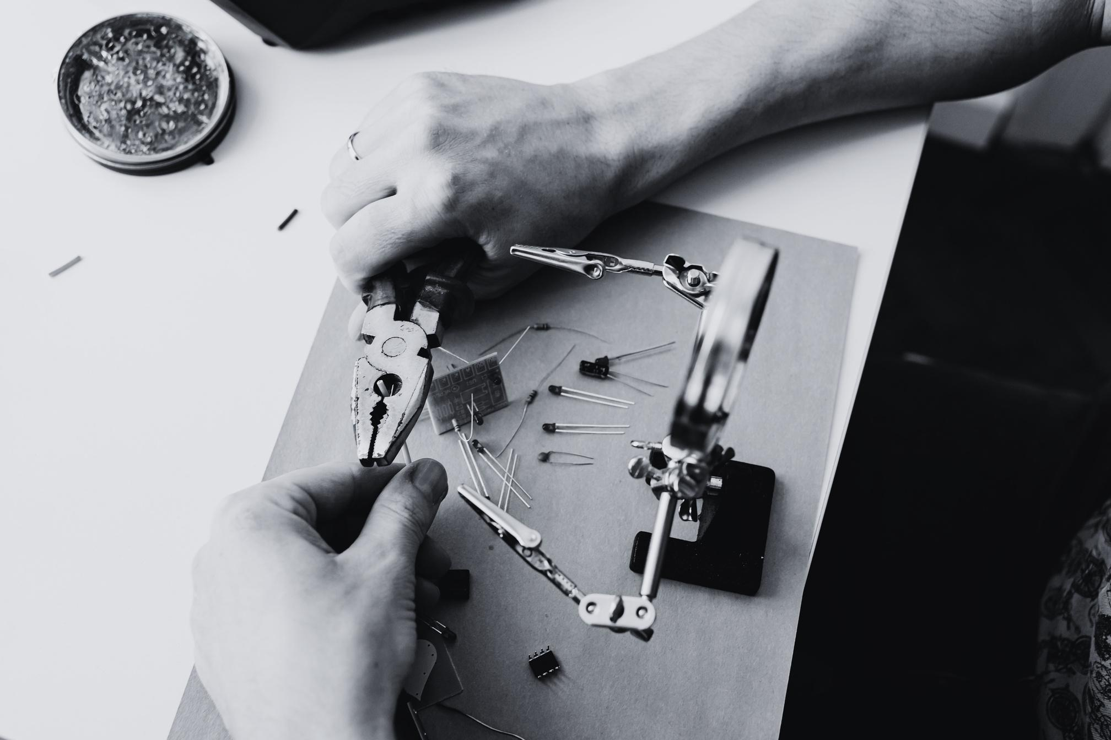
INTEGRATED
ELECTRONICS
Microelectronics
Electronics functions supplied to the user as irreducible units
To minimize the electronics equipment
Several approaches evolved
Combined with each other

Slide 4
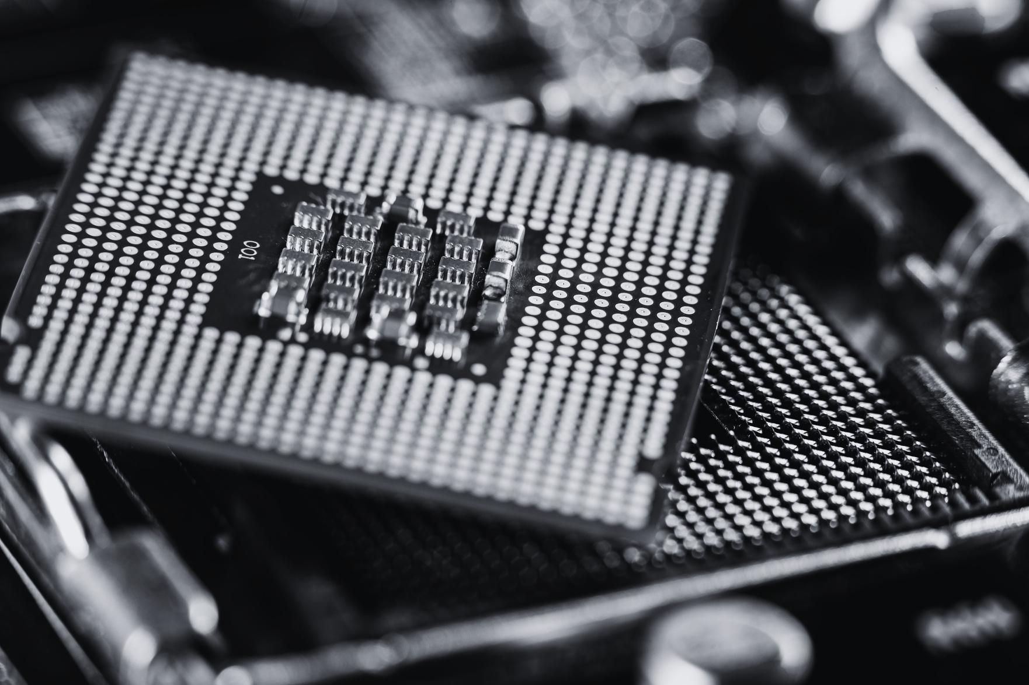
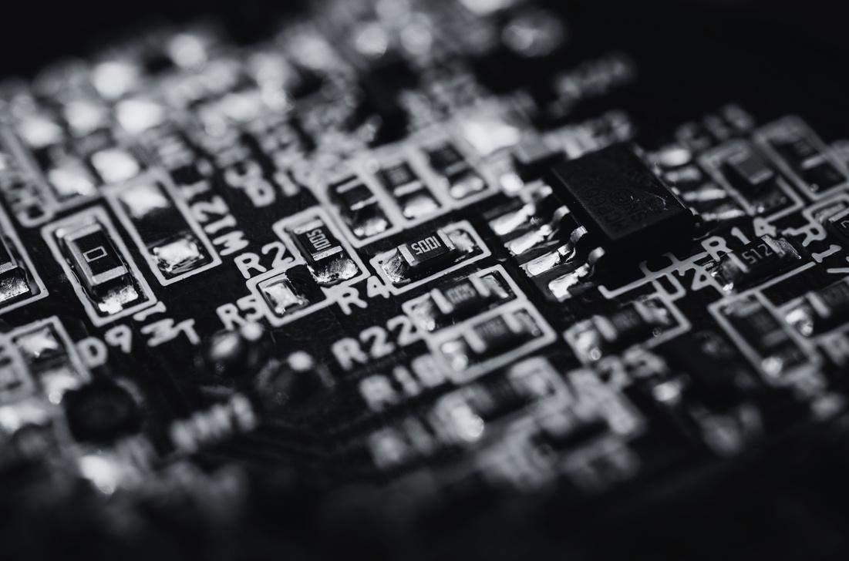
WHERE TO USE?
Mandatory for new military systems
  reliability, size, and weight
Commercial computer in design
  cost less, and perform well
Instruments using digital techniques
  low costs in manufacture and design
Linear integrated circuitry
  expensive, and few varieties

Slide 5
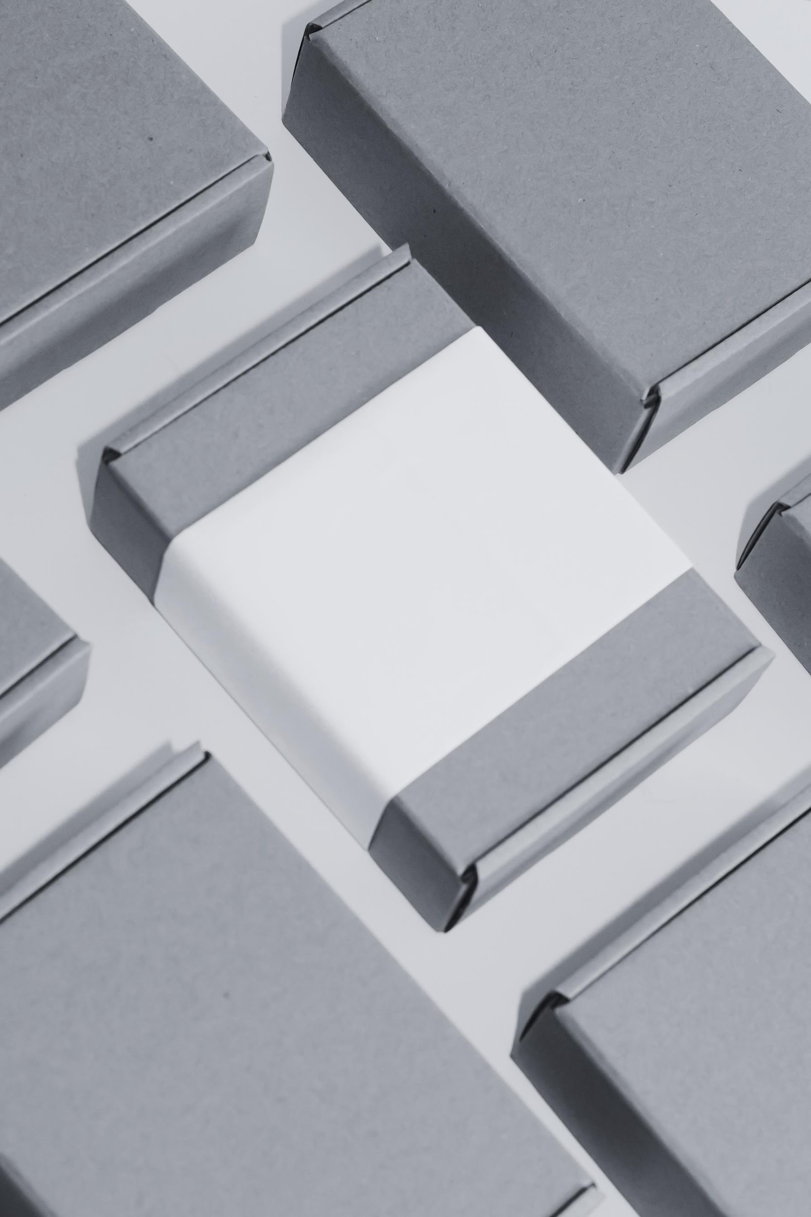
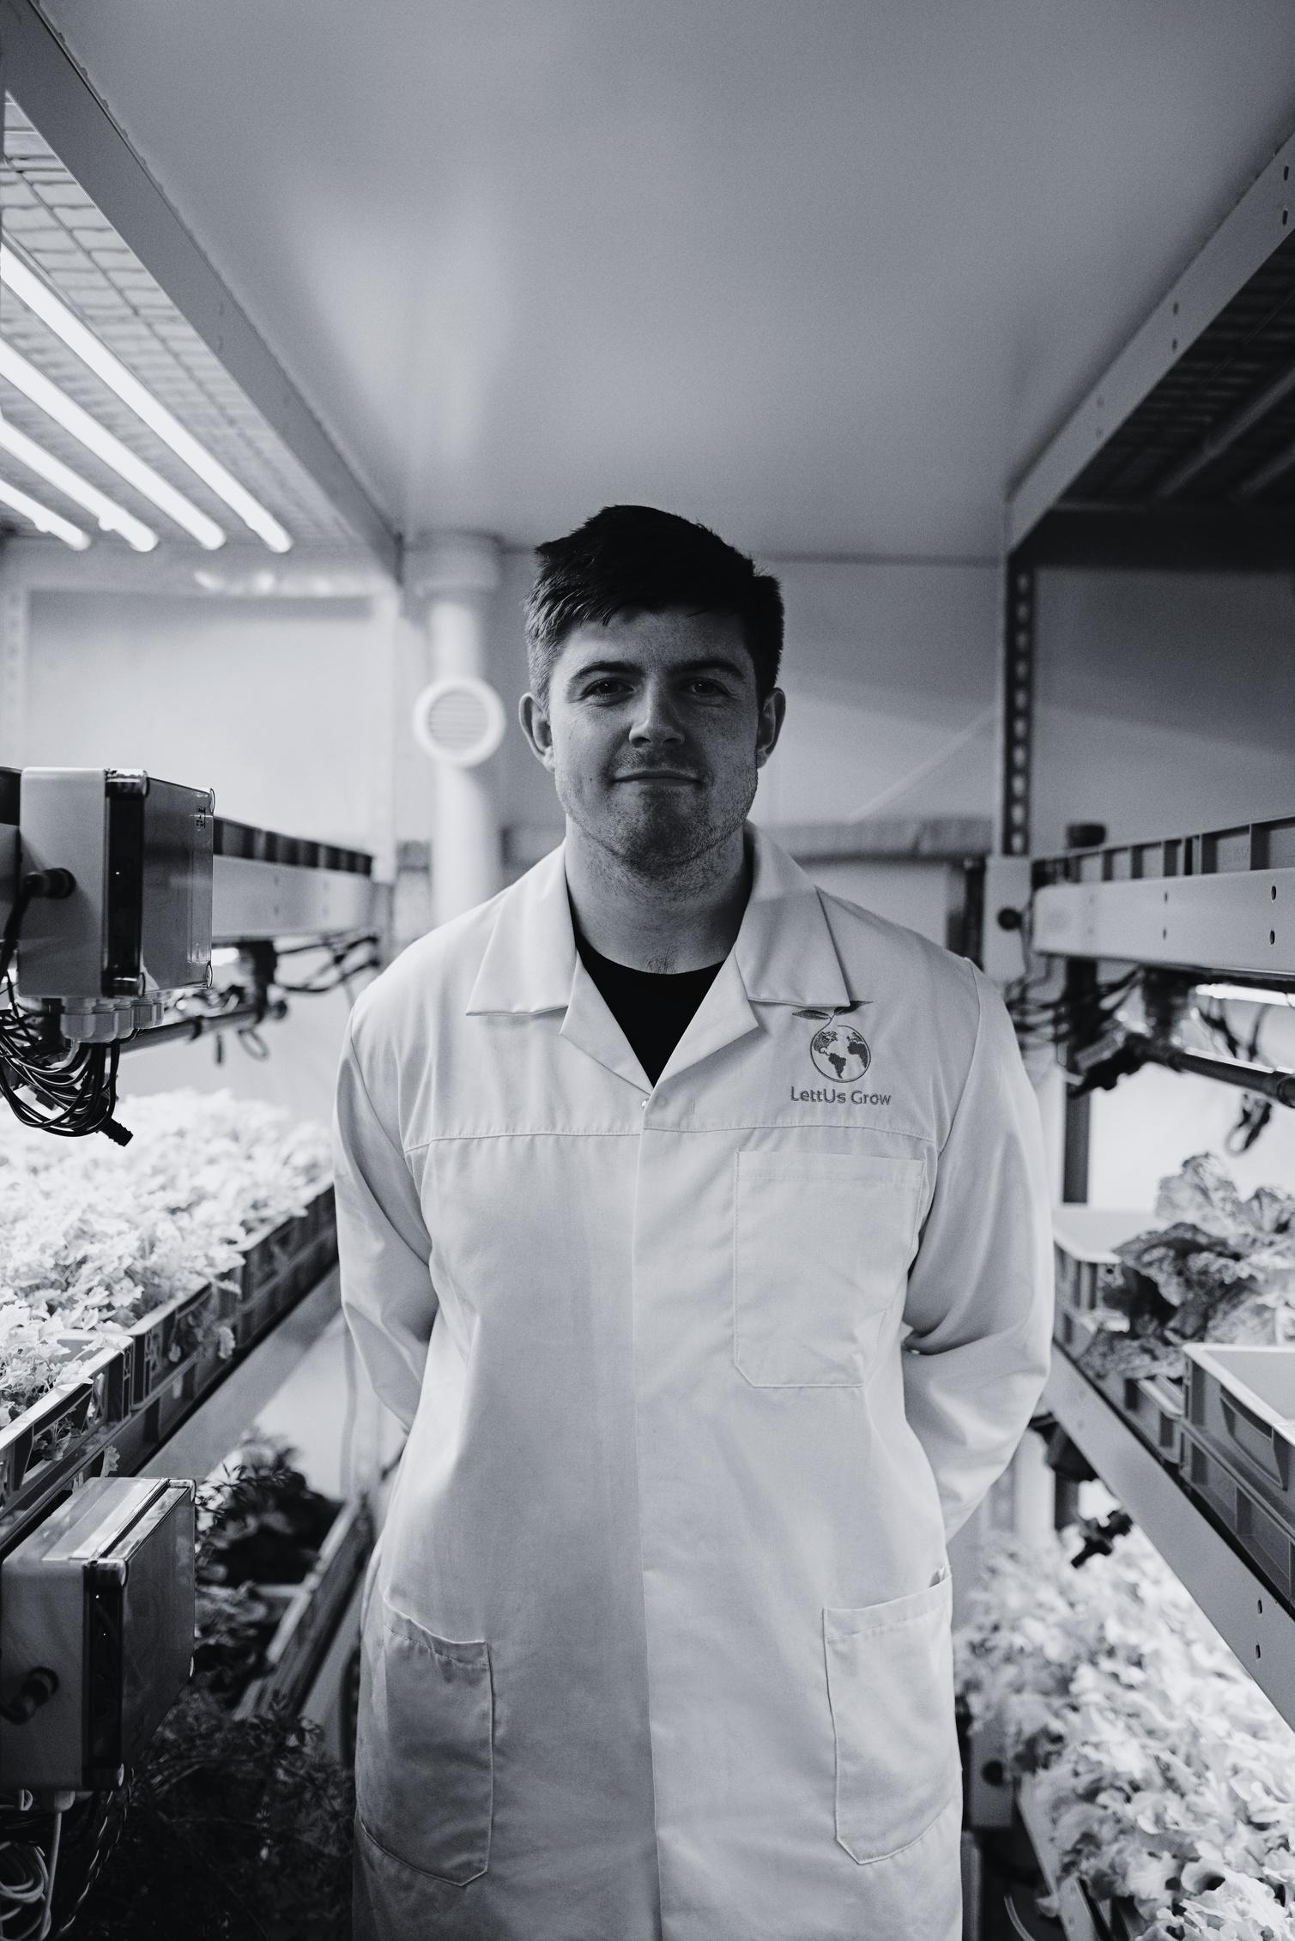
WHAT’S NEXT?
Reliable even at that production level
Lower costs and a greatly simplified design
Semiconductor integrated circuits will predominate
Silicon is likely to remain the basic material
  abundant and relatively cheap in low-freq

Slide 6
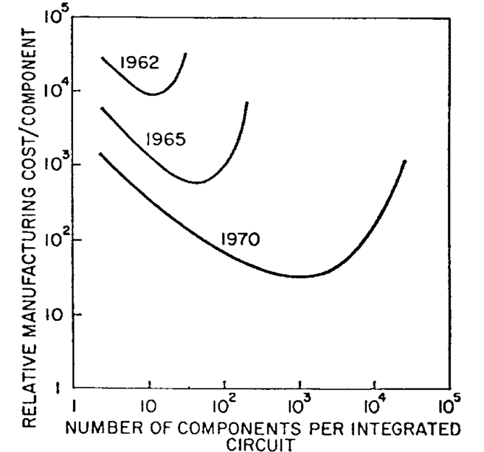
COST
Biggest Attraction
Continues to increase as the technology evolves toward the production of larger and larger circuit functions on a single semiconductor substrate
Curve:
When simple:
Equivalent package
Cost per component ≈ C​/N
When complex:
Yields Decrease

Slide 7
COST
Sweet Point: Minimal cost in each evolution
Cost decrease; Minimal cost point increases
The complexity for minimum component costs has increased at a rate of roughly a factor of two per year
By 1975, the number of components per integrated circuit for minimum cost will be 65000
A large circuit can be built on a single wafer

Slide 8
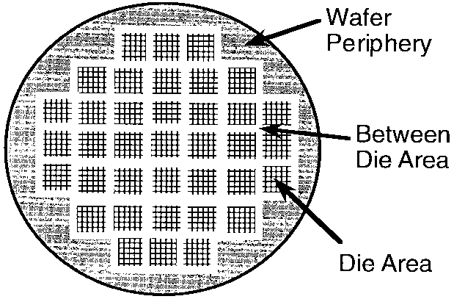
IS IT POSSIBLE?
Is it possible for 65000?
65000 components need to occupy only about one-fourth of a square inch.
  It is based on the existing fabrication tolerances, wafer sizes, and interconnect techniques—without relying on any exotic future technology.

Slide 9
IS IT POSSIBLE?
Is it possible to break through yield problems?
At present: packaging cost >> semiconductor structure
  If it is worthy, only the engineering effort is needed.
Historically, yields improved once higher integration became economically important; the same pattern was expected to repeat if desired

Slide 10
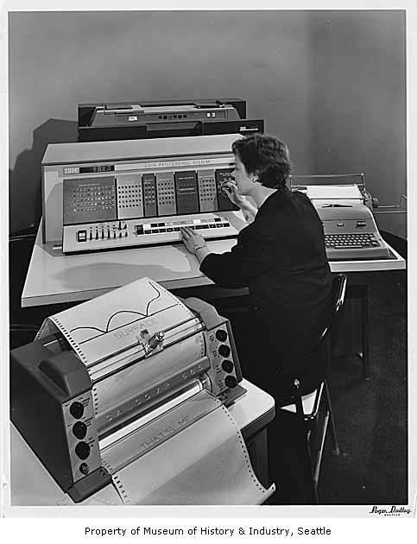
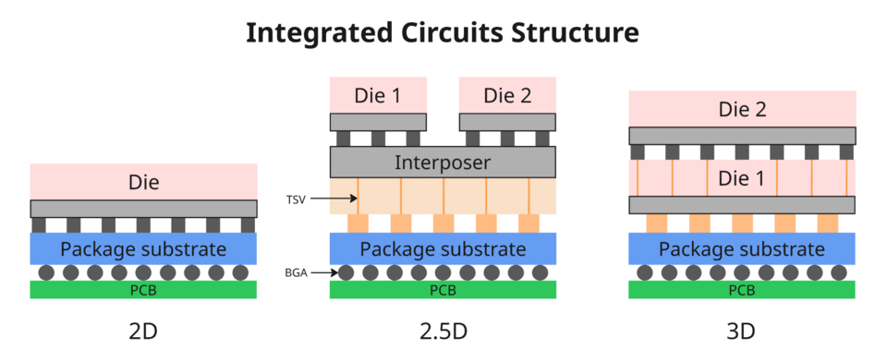
IS IT POSSIBLE?
Is it possible to break through heat problems?
  Naive scaling → excessive heat
  ICs are 2D → efficient heat removal
  Power dominated by interconnect lines and capacitance
  Smaller dimensions → less capacitance
  Higher speed at the same power density

Slide 11
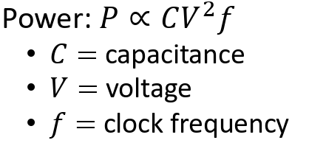
*DENNARD SCALING
As transistor dimensions scale down by a constant factor, voltage and current can also be reduced proportionally, allowing:
  Higher switching speed
  More transistors per unit area
  Nearly constant power density
As a result, early CMOS scaling enabled higher clock frequencies without increasing chip power consumption.

Slide 12

WHEN / HOW TO DO THIS ?
Total Cost Must be Minimized!
  Amortize the engineering
  Evolve flexible techniques
Logic diagram to technological realization
Build a large system by small functions
Modular Design

Slide 13
LINEAR CIRCUITRY
Would not be changed as radically as Digital Systems.
  The lack of large-value capacitors and inductors
Still, something looks promising
  Integrated RF amplifier: high performance at minimum cost
  Differential amplifier: matching, and tracking
  Oscillators: stability
  Microwave area: Assemble components small compared with the wavelengths

Slide 14
DISCUSSIONS
What assumptions/advocate did the author make to derive the prediction:
With unit cost falling as the number of components per circuit rises, by 1975, economics may dictate squeezing as many as 65000 components on a single silicon chip？

Slide 15
DISCUSSIONS
Among all the assumptions, which one do you think matters the most？

Slide 16
DISCUSSIONS
Which assumption/ advocate do you think is not valid in the short term？

Slide 17
DISCUSSIONS
Which assumptions/ advocates/ insights do you think are still valid today?

Slide 18
DISCUSSIONS
Mr. Moore, what should we do when the smallest dimensions of our transistors are less than a few atoms across and we cannot shrink them any further?

